Slide 1


VE450 Edge Online Training
Weekly Report #12
2018.11.28

Slide 2
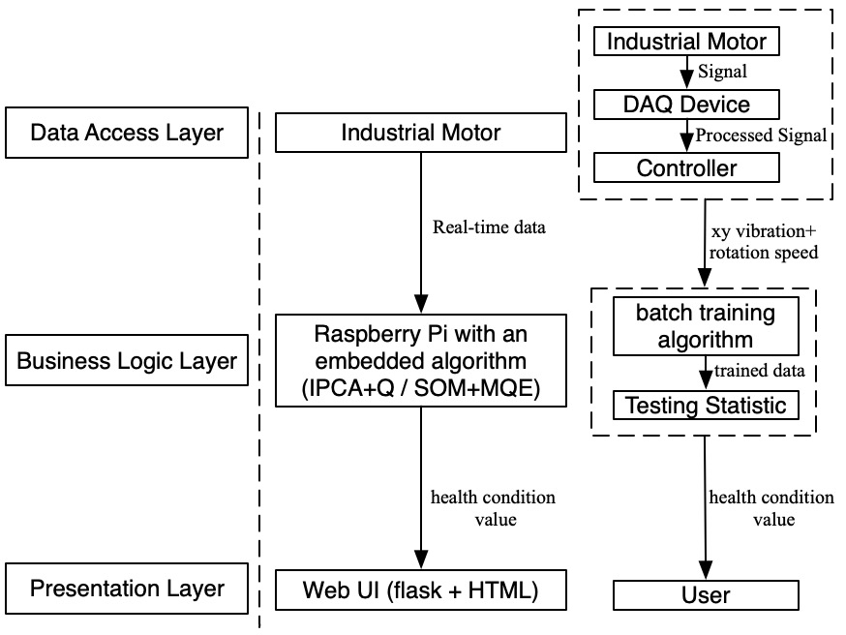

Overview of the whole project
Efficiency
Accuracy
User friendly

Slide 3
The materials for expo
Team 17 Adaptive Motor Monitoring System Based on Machine Learning Batch Training
(基于批量训练和机器学习的电机健康状况适应性监测系统)
Motor, as one of the most important equipment in various fields, plays an important role in today’s manufacturing. Effective motor health monitoring system can help fix the problem quickly or even detect the problem prognostically so that the production efficiency can be improved. A traditional data-driven approach is based on cloud training, ie. transferring the data to the cloud and training the model on the cloud. However, that process is time-consuming and data may lose during that process. Moreover, traditional systems always adapt an “one-time” model, which means that the model will never change once the train finishes.
Our monitoring system, based on edge batch training can solve the problem well. The train of model and detection of motor is place on the edge side, ie. the side of the source of data. That saves a lot of time and the probability of loss of data is reduced to great extents. What’s more, as batch training supports training the model by batches of data, it guarantees the adaptivity of the model. That is because the users can update the model by a new batch of data based on the latest motor condition.

Slide 4
The materials for expo
Team 17 Adaptive Motor Monitoring System Based on Machine Learning Batch Training
(基于批量训练和机器学习的电机健康状况适应性监测系统)
电机，作为许多领域的重要器件，在工业生产，制造中起着重要的作用。有效的电机健康状况监测系统能够帮助及时排除故障甚至是预防性监测故障，从而提高生产效率。传统的数据驱动型电机健康状况监测系统通常使用云端训练，即数据传送至云端再训练模型。然而，此数据传输过程中需要花费大量时间，同时在此过程中数据很有可能产生丢失。 此外，传统系统通常使用同“一次性”训练模型。这意味着模型一旦训练完成，将永远不再更改。这样的模型很显然缺乏适应性。
我们的监测系统，基于边缘端的批量训练，能够很好解决这一问题。模型的训练以及电机状态的监测环节被放在了靠近电机，即数据源头一侧。这大大节约了传统云计算传输数据所需的时间以及降低了数据丢失的可能性。同时，批量训练支持训练模型的过程中，数据批量处理。这意味着用户可以所示根据新的电机状况，即新数据，对于原有模型进行更新，确保模型的适应性。

Slide 5
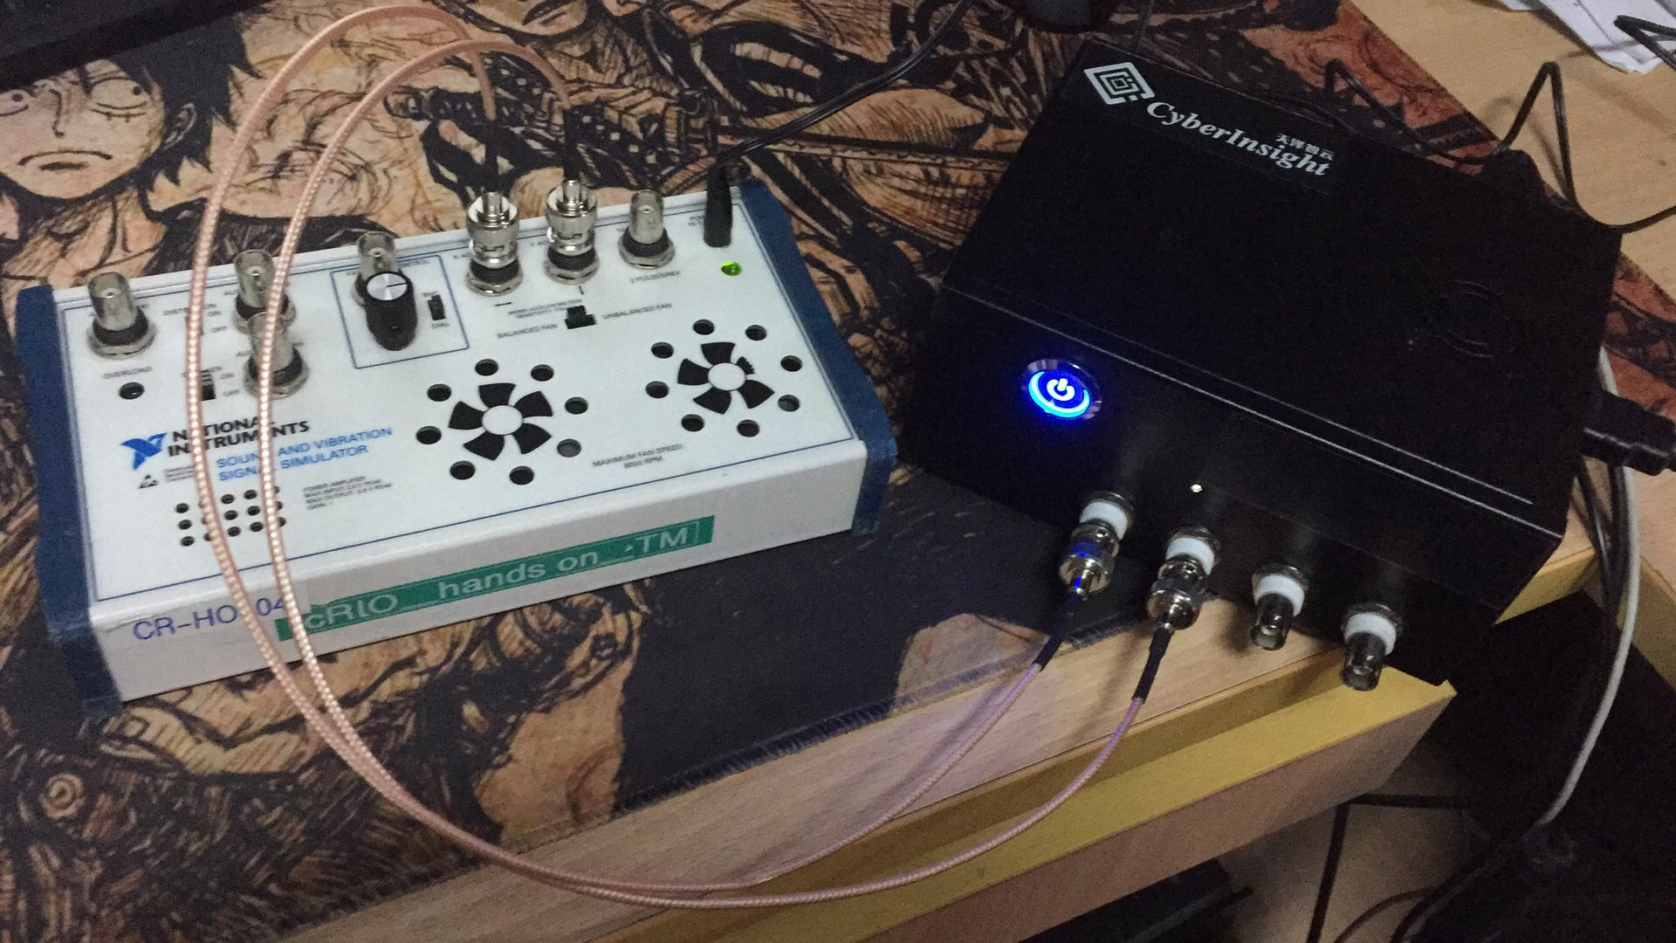
Current Result
- Hardware
Raspberry Pi
Signal source

Slide 6
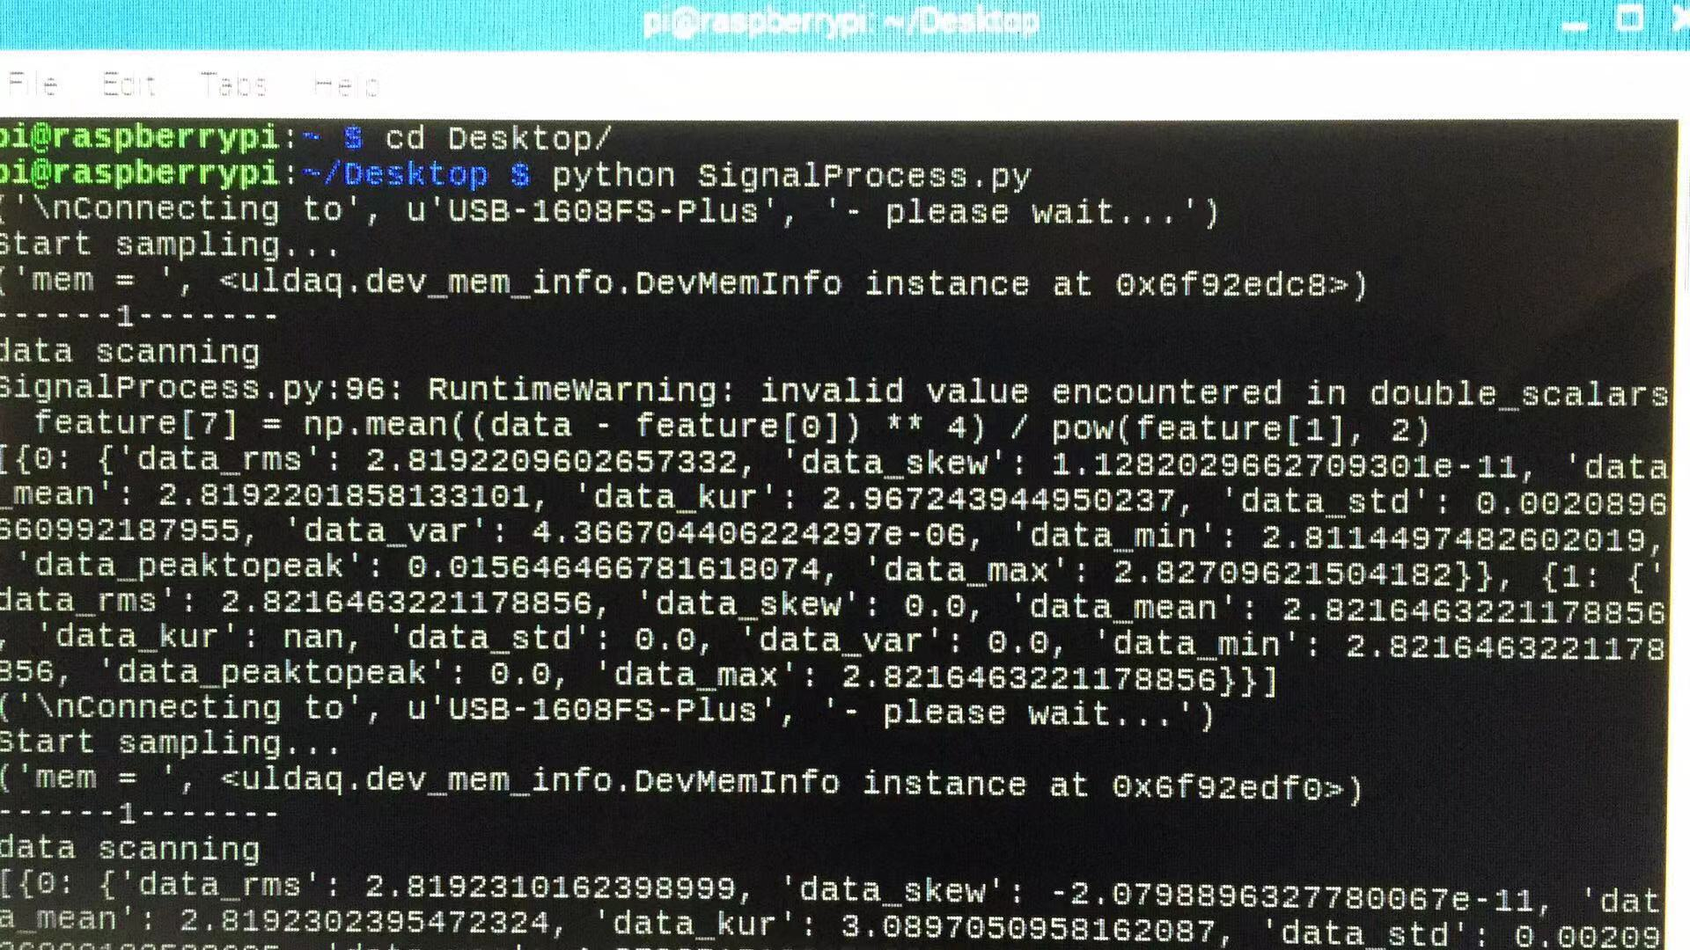
Collecting data from the signal source

Slide 7
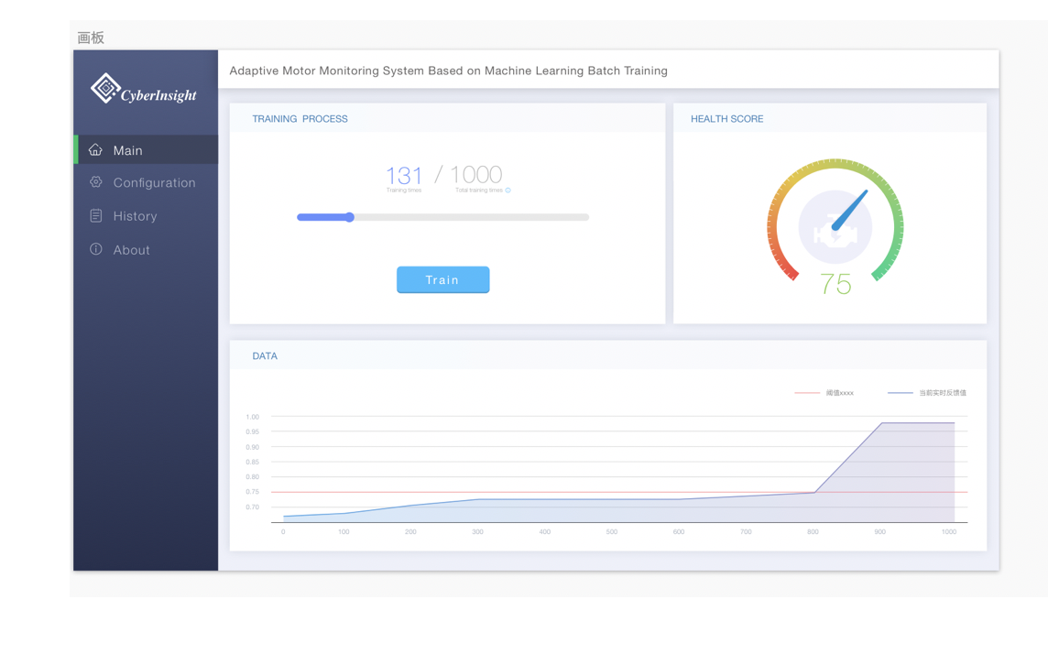
Current Result
- Demo Interface
Real time train process
Health Score of the motor
Health health score
Red line: threshold
Above the threshold- abnormal

Slide 8
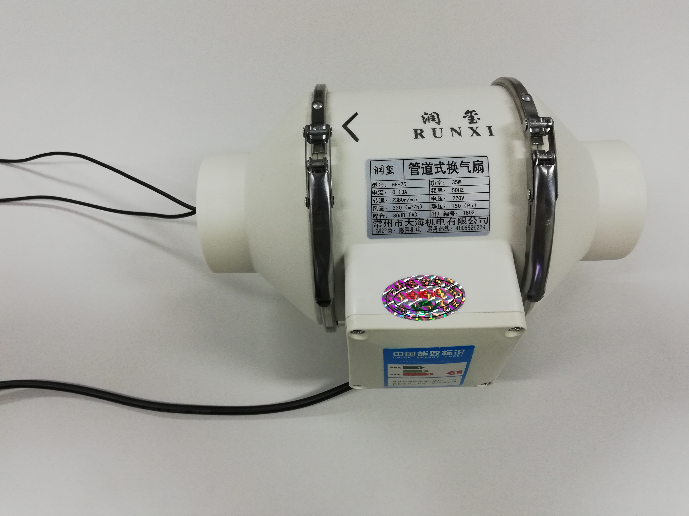
Plan for the demo in expo
Replace the signal source by a pipe type
Ventilating fan；*
2. Demo Interface on a big screen；
3. Involvement of judgement penal &
The audience;

Slide 9

Functions provided by Web services
Only rough design of the UI surface->will improve

Slide 10
Future Plan
Improvement of Web UI;
2. New method of demo (simulation box->pip type fan): may need time
3. VE450 course related work: Final report & Final ppt

